Slide 1


6
Repeating Instructions
C# Programming: From Problem Analysis to Program Design
3rd Edition

Slide 2
Chapter Outline
while Statement
do-while Statement
for Statement

Slide 3
1. while Statement
while (expression)
{
statement(s);
}

Slide 4
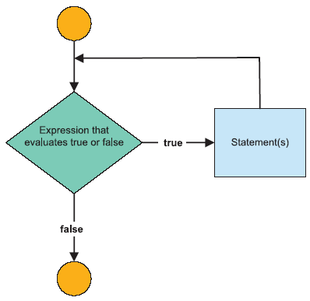
while Statement

Slide 5
while Loop Example 1
int sum = 0;
int number = 1;
while (number < 11)
{
sum = sum + number;
number++;
}
Console.WriteLine("Sum of values 1 to 10 is "
+ sum);

Slide 6
while Loop Example 2
string aValue ;
int intValue;
int total;
Console.Write("Enter a value (-99 to stop)");
aValue = Console.ReadLine();

Slide 7
while Loop Example 2 (cont’d)
while (aValue != "-99")
{
intValue = Convert.ToInt32(aValue);
total += intValue;
Console.Write("Enter a value (-99 to stop)");
aValue = Console.ReadLine();
}
Console.WriteLine("Total of values entered {0}",
total);

Slide 8
2. do-while Statement
do
{
statement(s);
}
while ( conditional expression);

Slide 9
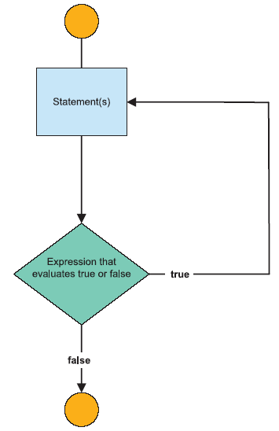
do-while Statement

Slide 10
do-while Loop Example
int counter = 10;
do
{
Console.WriteLine(counter);
counter--;
}
while (counter > 6);

Slide 11
3. for Statement
for ( initialization-statement;
conditional-expression;
update-statement )
{
statement(s)
}

Slide 12
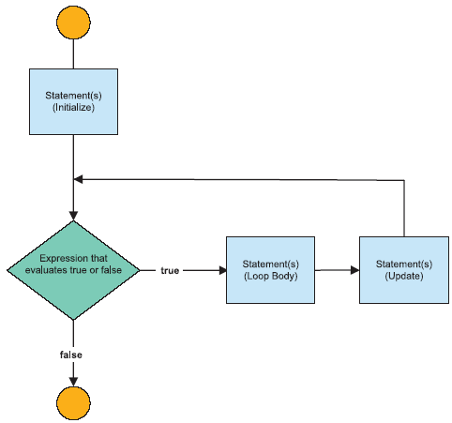
for Statement

Slide 13
for Loop Example
int toPower2, toPower3;
for (int counter = 0; counter < 11; counter++)
{
toPower2 = (int) Math.Pow(count,2);
toPower3 = (int) Math.Pow(count,3);
Console.WriteLine("{0}\t{1}\t{2}",
counter, toPower2, toPower3);
}

Slide 14
Nested Loops
int outer, inner;
for (outer = 0; outer < 3; outer++)
{
for (inner = 10; inner > 5; inner--)
{
Console.WriteLine("Outer: {0}\tInner: {1}",
outer, inner);
}
}

